Slide 1

GUIDED BY GRACE, EMBRACED BY HOPE
Asher Kynan G. Medriano

Slide 2







Slide 3
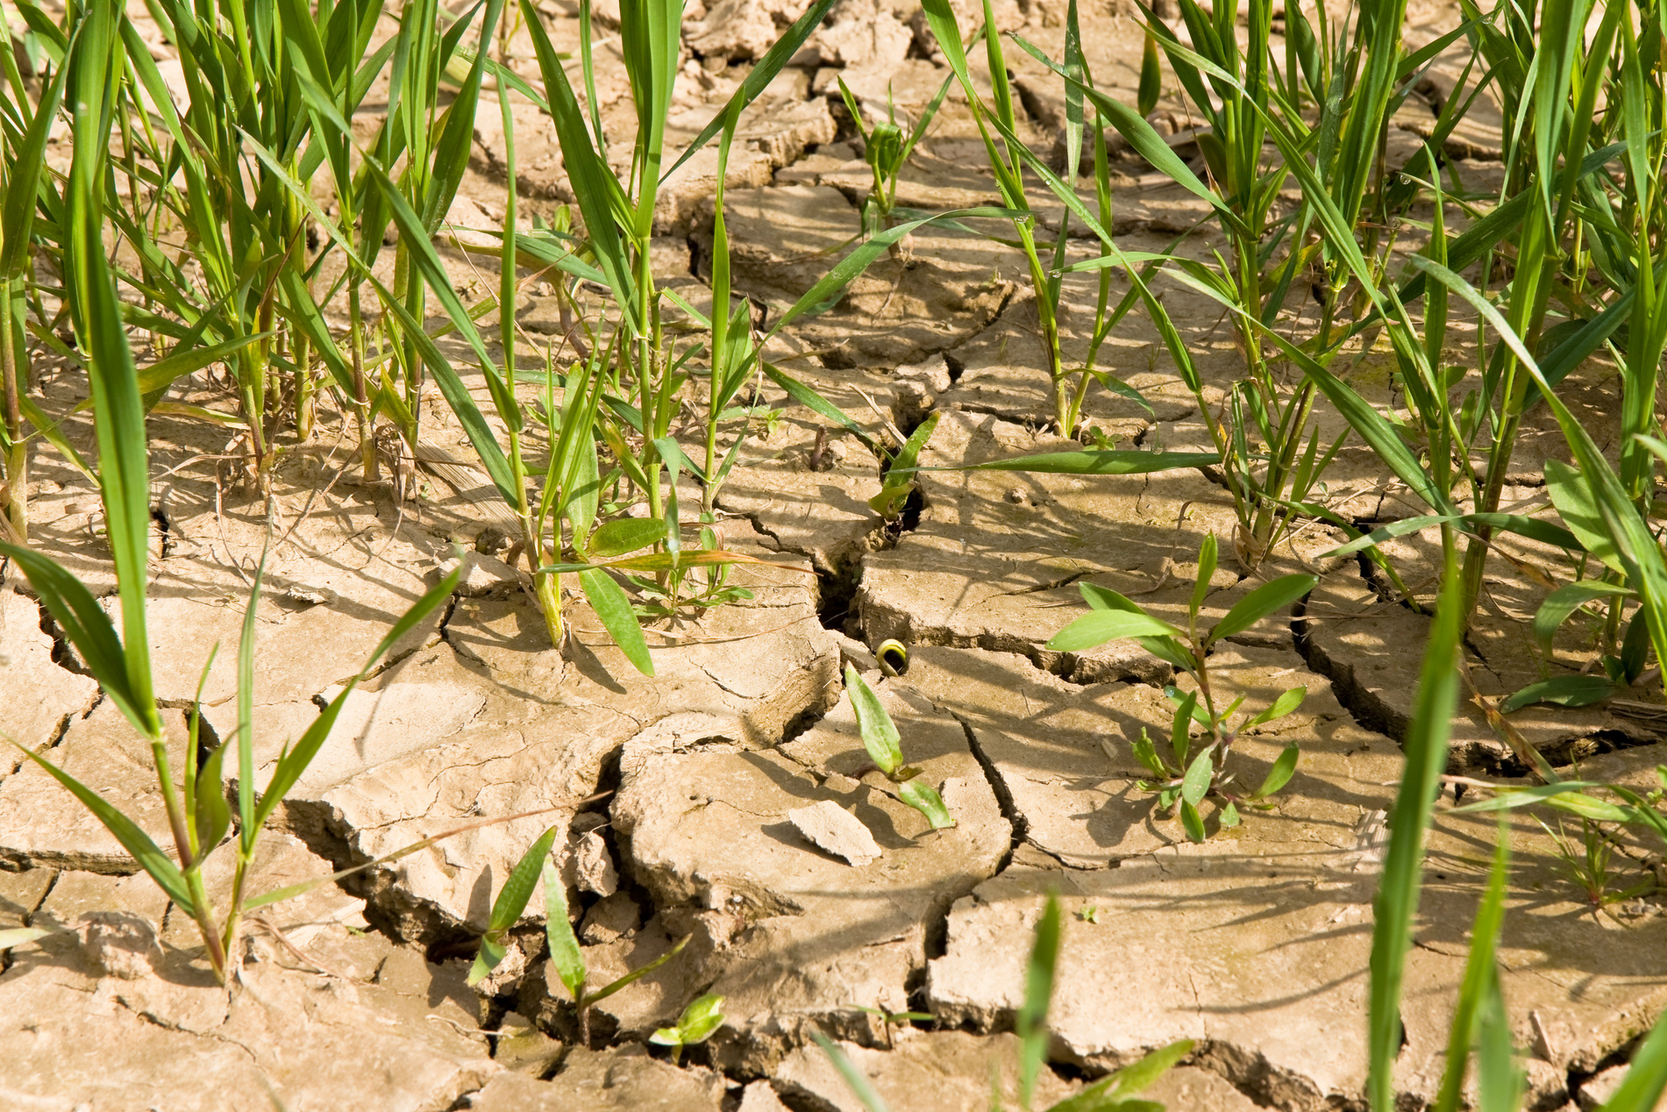
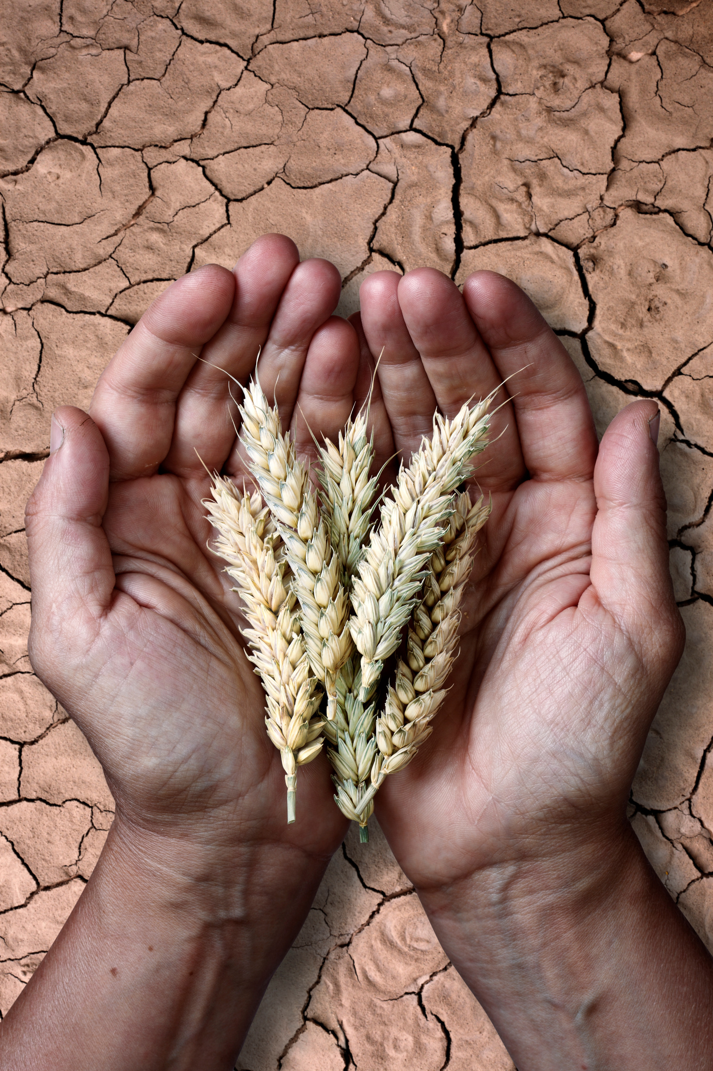
Famine

Slide 4
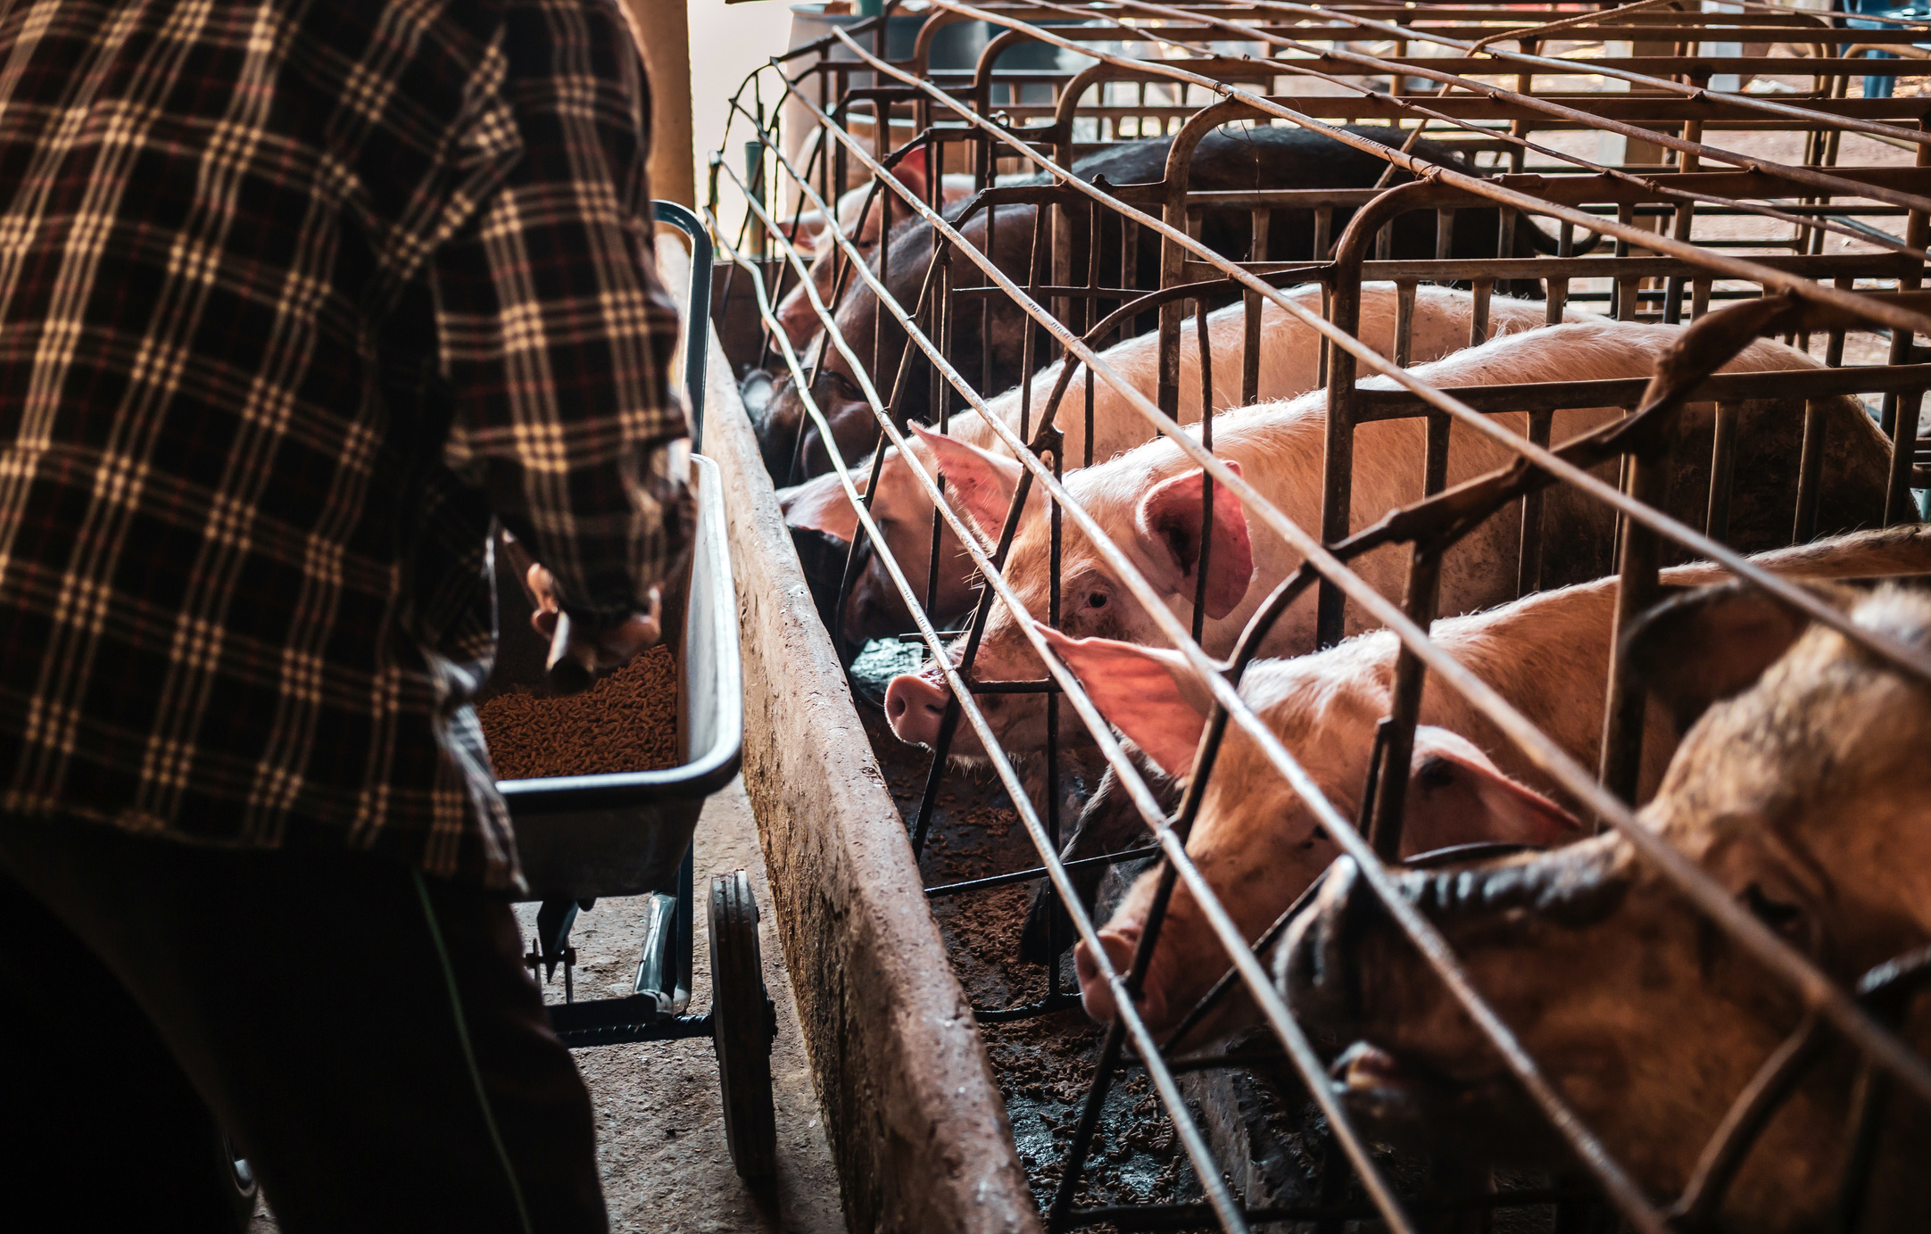

Slide 5
LUKE 15:17-19
"And when he came to himself, he said, How many hired servants of my father’s have bread enough and to spare, and I perish with hunger! I will arise and go to my father, and will say unto him, Father, I have sinned against heaven, and before thee, And am no more worthy to be called thy son: make me as one of thy hired servants."

Slide 6
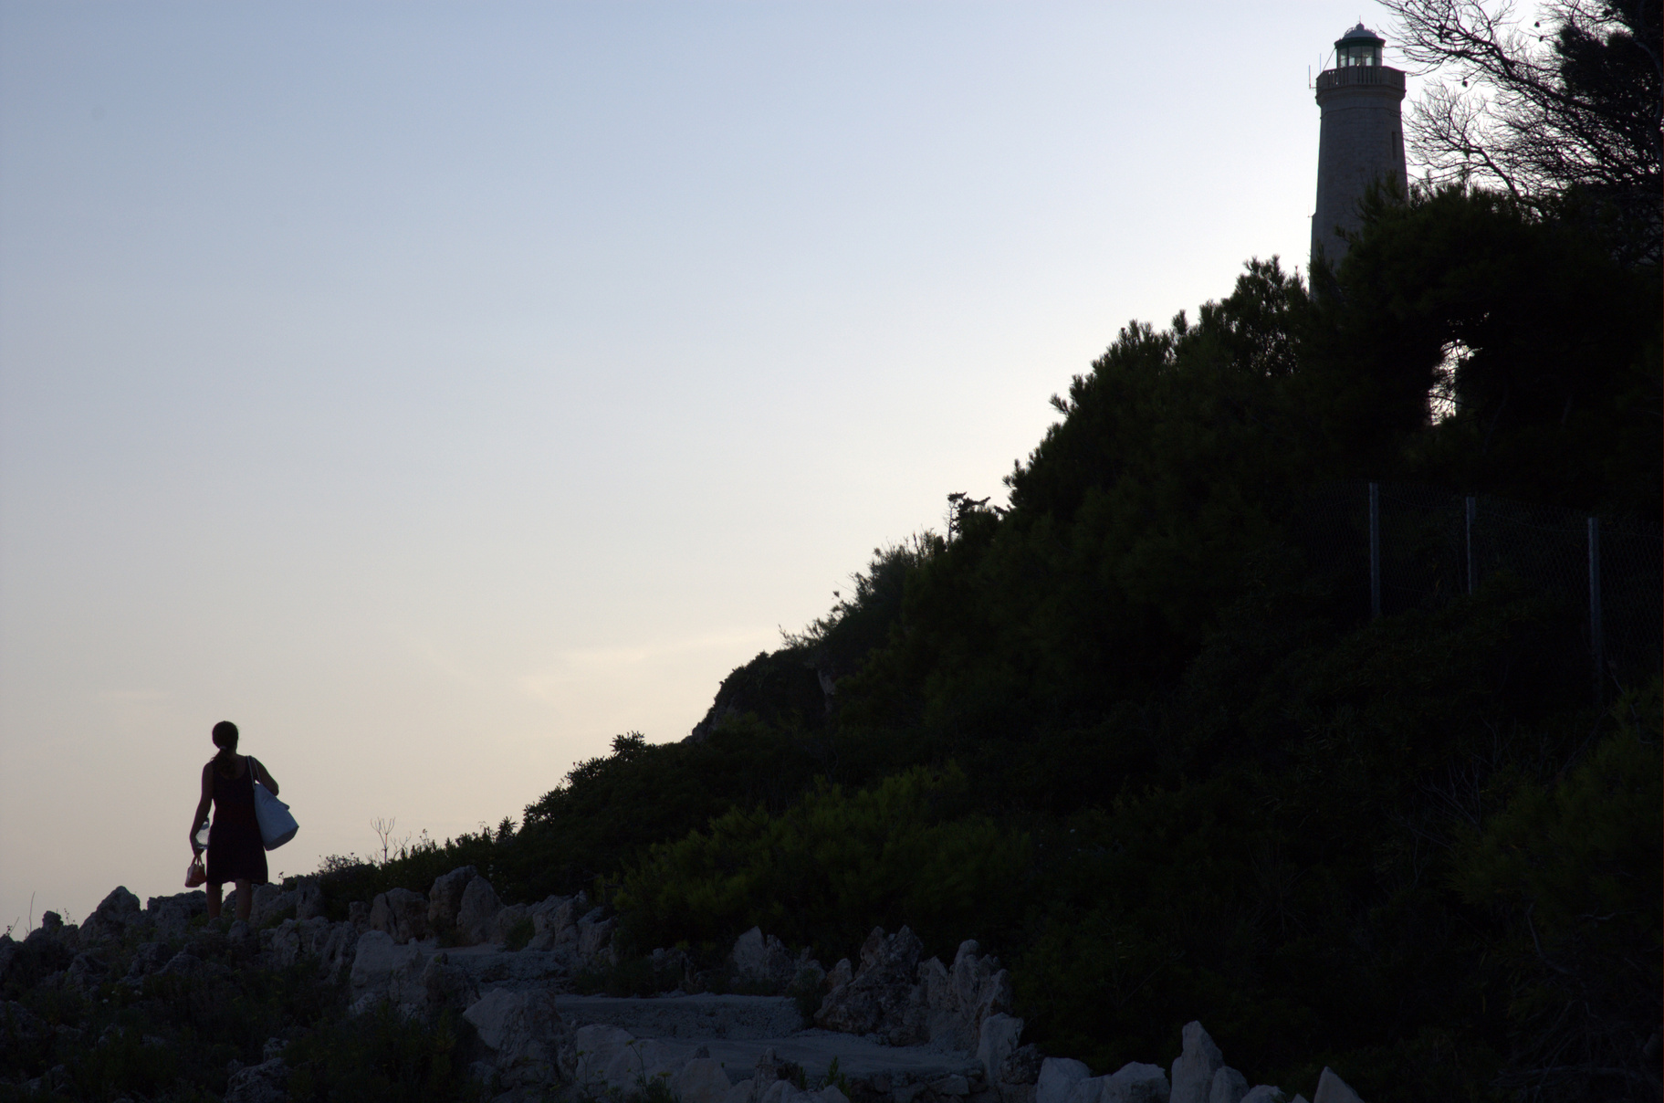

Slide 7
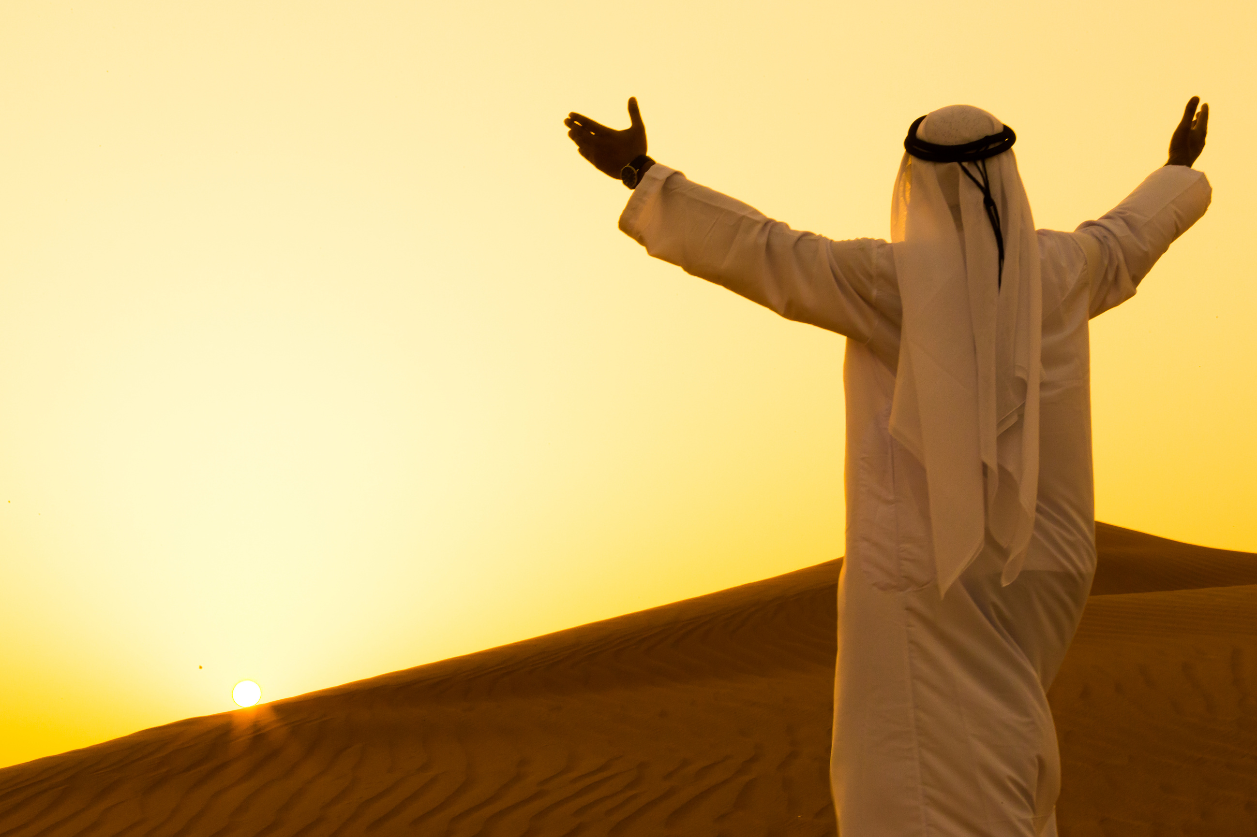

Slide 8
LUKE 15:22-24
"But the father said to his servants, Bring forth the best robe, and put it on him; and put a ring on his hand, and shoes on his feet: And bring hither the fatted calf, and kill it; and let us eat, and be merry: For this my son was dead, and is alive again; he was lost, and is found. And they began to be merry."

Slide 9


Slide 10
God’s forgiveness is not just pardon; it’s
a restoration of relationship.

Slide 11
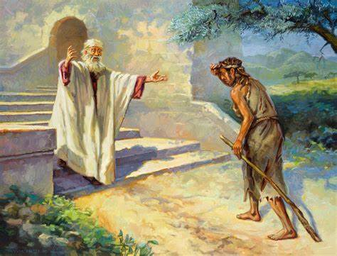

Slide 12
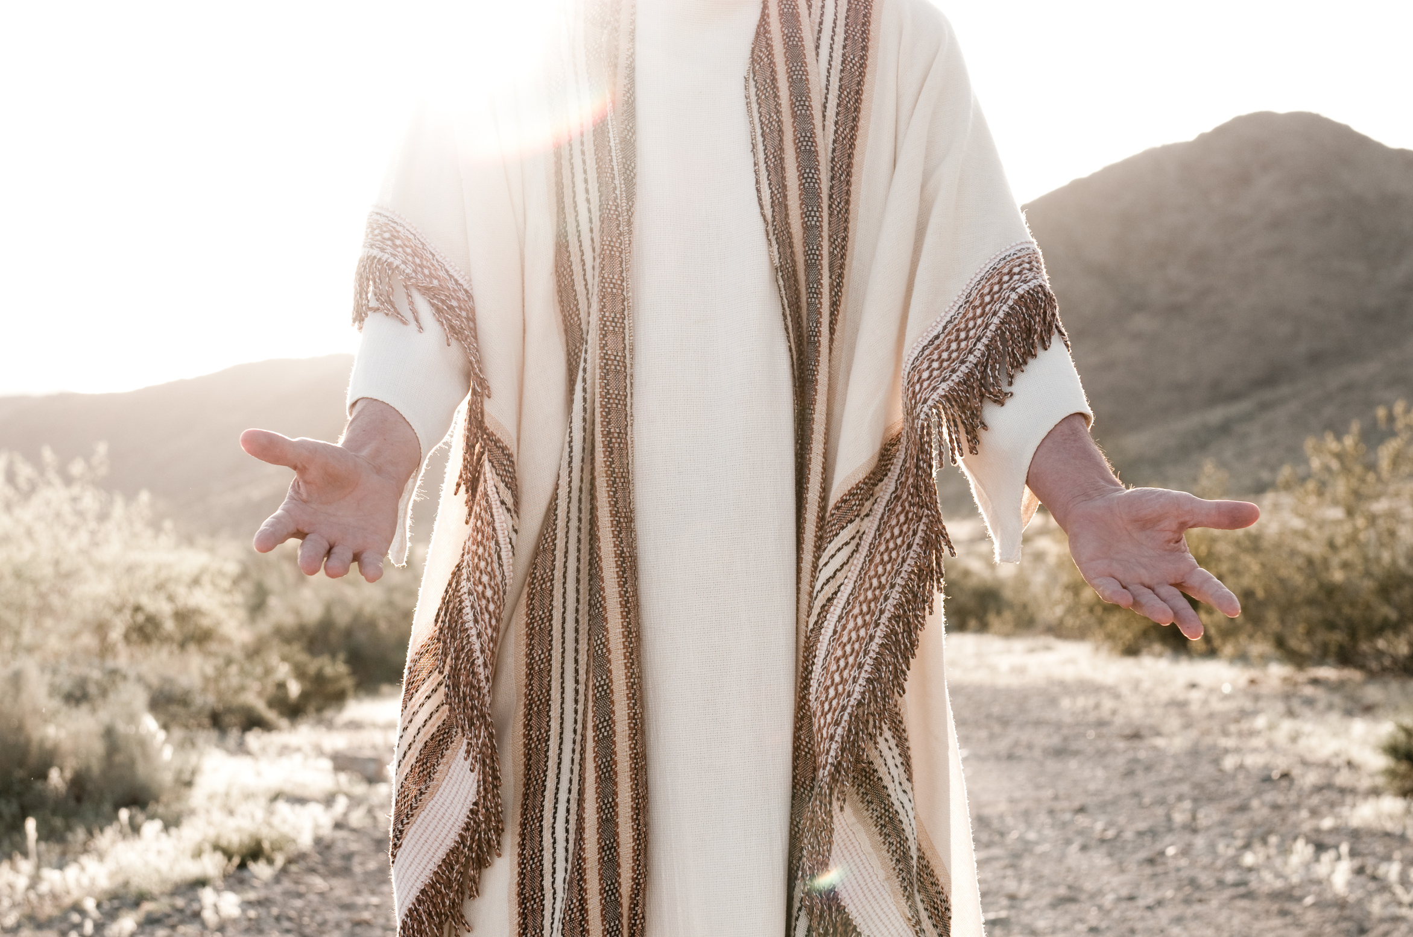

Slide 13
Grace and hope are two powerful forces that can transform our lives.

Slide 14
GRACE
Grace is the undeserved favor and love of God. It is the reason we can be forgiven and restored to a right relationship with Him.

Slide 15
EPHESIANS 2:8-9
For by grace ye are saved through faith; and not of yourselves: it is the gift of God, not of works, lest any man should boast.

Slide 16
HOPE
Hope is the confident expectation of good things to come. It is the belief that even in the midst of difficult circumstances, God is working for our good.

Slide 17
TITUS 2:13
Looking for the blessed hope, and the glorious appearing of the great God and our Saviour Jesus Christ.

Slide 18
